Slide 1

Fast Facial Expression Recognition Using Multiple Pyramid Strategy
Chengjun Yuan
Yijun He
Dec. 3 2015

Slide 2
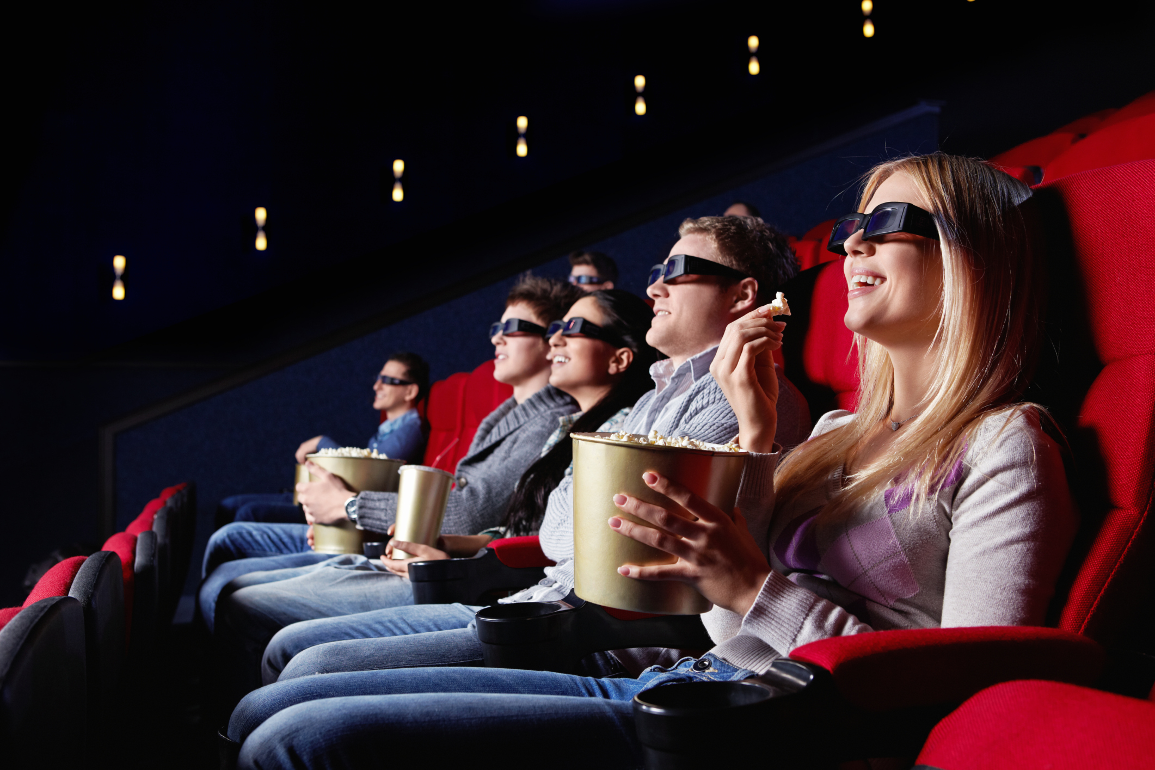
Motivation
55%
EXPRESSION
38%
TONE
7%
CONTENT
Robot understand human | Speech Recognition
Measurement of behavior
Movie Reviews
LIKE | UNLIKE
Notes:
When people face to face communication,

Slide 3
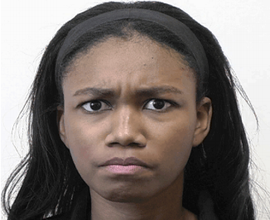
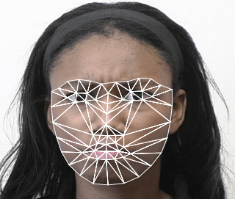
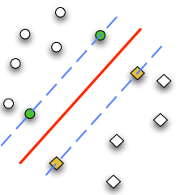
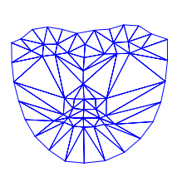
Background
Face Image In
Extract Features
SVM Classifier
Lucey, et al. 2010
Psycho-visual Study
MOUTH
& EYES
Anger
Fear
Disgust
Happy
Sadness
Surprise
MOUTH
Khan, et al. 2013

Slide 4
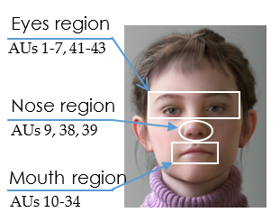
Related Work
Vo & Ly. 2015 Two Levels Strategy
1st Level
Mouth Features SVM
FACS | 43 AUs
Happy
Sadness
Surprising
2nd Level
Mouth + Eyes Features SVM
Anger
Fear
Disgust
96.7% | 256 LPQ Features
No consider other regions | 3 Levels
Notes:
LPQ: local phase quantization. Feature extraction method.
The most common used model for facial representation is facial action coding system (FACS)[3]. It introduced Action Units (AU) to express facial movements. Action Units are a set of actions that correspond either to muscle movement in facial expressions such as raising upper lip or blinking, or some miscellaneous actions such as bite lip or blow. The FACS consists of up to 43 action units. However, as we know, more information of facial expression is appeared in the eyes, eyebrows and mouth region than other regions. These regions are called “salient regions” where “salient” means most noticeable or most important.

Slide 5
Claim / Target Task
Explore Multiple Level Pyramid strategy
on Facial Expression Recognition
2
LEVELS
3
LEVELS
WHICH
BETTER
BENEFITS
PRICE
Notes:
Here, we make the claim of this project.

Slide 6
Proposed Solution
Three Level Pyramid Strategy
1st level
Mouth AUs SVM
Happy
Contempt
2nd level
Mouth + Eyes SVM
Anger
Surprising
3rd level
Mouth + Eyes + Nose SVM
Sadness
Disgust
Fear
Notes:
Here is our proposed solution.

Slide 7
Implementation
One level
Optimization Layer by Layer
7
Two levels
3
4
Three levels
Exhaustion
+ LOO-CV
1
2
4
Notes:
We start from one level – normal SVM classification to tune the parameters for optimal performance. Then divide into two levels. We will exhaust all possibilities for each division of two level strategy and find the optimal performance. Based on the two level optimal division, we will continue to explore the three level strategy. In conclusion, we optimize the classification layer by layer. LOO-CV

Slide 8
Data Summary
Extended Cohn & Kanade AU-coded
Expression Database
129
POSTERS
43
AUs
327
SEQUENCES
7
EXPRESSIONS
45 ANGRY
83 SURPRISE
18 COMTEMPT
28 SADNESS
59 DISGUST
69 HAPPY
25 FEAR
Notes:
In the rest of this presentation, I’m going to talk about following contents:

Slide 9
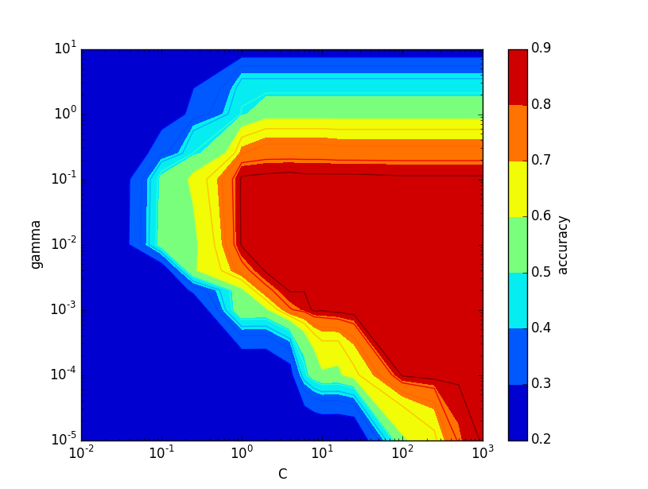
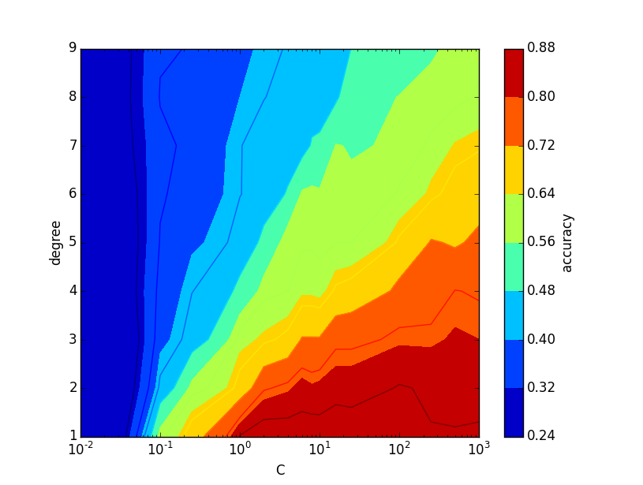
Experimental Results
Select Parameters of SVM
RBF
POLY
RBF
KERNEL
4
C
0.01
GAMMA
88.1%
ACCURACY
Notes:
One level classification that consider all 43 AUs features in SVM to classify all expressions.

Slide 10
Experimental Results
Optimal Two
Levels Strategy
1st Level
Optimal Three
Levels Strategy
2nd Level

Slide 11
Experimental Analysis
3
LEVELS
2 LEVELS
Three-levels improves accuracy based on optimal two-levels.
88.8%
UPPER LIMIT
OF ACCURACY
Accuracy decreases as more targets classified in lower levels.

Slide 12
Experimental Analysis
Vo 2015 Two Levels
Optimal Two Levels
1st Level
Mouth AUs SVM
Mouth AUs SVM
Happy
Sadness
Surprising
Happy
Contempt
Fear
2nd Level
Mouth + Eyes + Nose SVM
Mouth + Eyes + Nose SVM
Anger
Fear
Disgust
Contempt
Anger
Sadness
Disgust
Surprising
77.5%
85.6%
96.7% | 256 LPQ Features
Notes:
In the rest of this presentation, I’m going to talk about following contents:

Slide 13
Conclusion and Future Work
WHICH
BETTER
Three-levels contributes to more accurate and ROBUST classification than two-levels
BENEFITS
Improve accuracy
PRICE
Accuracy decreases as more targets classified in lower levels
WHY
UPPER LIMIT
MORE
FEATURES

Slide 14
References
[1] THE 7% RULE. http://ubiquity.acm.org/article.cfm?id=2043156
[2] Vo, A. and N.Q. Ly, Facial Expression Recognition Using Pyramid Local Phase 123 Quantization Descriptor, in Knowledge and Systems Engineering. 2015, Springer. p. 124 105-115.
[3] Kanade, T., J.F. Cohn, and Y. Tian. Comprehensive database for facial expression 201 analysis. in Automatic Face and Gesture Recognition, 2000. Proceedings. Fourth IEEE 202 International Conference on. 2000. IEEE
[4] Lucey, P., et al. The Extended Cohn-Kanade Dataset (CK+): A complete dataset for action 204 unit and emotion-specified expression. in Computer Vision and Pattern Recognition 205 Workshops (CVPRW), 2010 IEEE Computer Society Conference on. 2010. IEEE.
[5] Bartlett, M.S., et al. Recognizing facial expression: machine learning and application to 198 spontaneous behavior. in Computer Vision and Pattern Recognition, 2005. CVPR 2005. 199 IEEE Computer Society Conference on. 2005. IEEE.

Slide 15
Labor Division
Chengjun Yuan
Yijun He
Paper Collection
Ideal Discussion
Data Collection
Implementation & Analysis
Write Reports
Make PPT
Paper Collection
Ideal Discussion
Experimental Discussion
Make PPT

